Slide 1
Digital portfolio
College name : MERIT HAJI ISMAIL SAHIB ARTS AND SCIENCE COLLEGE PERNUMBUT KONDAPALLI VILLAGE
THIRUVALLUR UNIVERSITY
NAME : Mohammed faizan .E
Branch : BCA

Slide 2
Project overview
“This project is a personal portfolio website designed to showcase my skills, academic background, and web development projects in an interactive and professional way. It serves as a digital resume and creative platform to highlight my technical expertise and creativity.” 🔹 “The portfolio project demonstrates my ability to design and develop a responsive, user-friendly website. It provides visitors with insights into my work experience, projects, and technical skills while reflecting my design sense and problem-solving abilities.” 🔹 “The main objective of this portfolio project is to create a well-structured, visually appealing, and easy-to-navigate platform that highlights my journey as a web developer. It emphasizes modern design principles, clean layouts, and functional features to leave a lasting impression.”

Slide 3
Project statement
🔹 “In today’s competitive digital world, having a strong online presence is essential. Many developers struggle to showcase their skills and projects in a professional way, which limits opportunities.” 🔹 “Traditional resumes often fail to highlight the practical skills and creativity of a developer. A portfolio website solves this by providing an interactive and engaging platform to demonstrate expertise.” 🔹 “The problem identified was the lack of a personalized digital space where I could present my projects, skills, and experiences in a structured, accessible, and visually appealing manner.”

Slide 4
Who are the end users?
🔹 “The end users of this portfolio project are recruiters, hiring managers, and potential employers who are looking to evaluate my technical skills and creativity.” 🔹 “This portfolio website is designed for industry professionals, clients, and organizations who want to learn more about my work, skills, and projects.” 🔹 “The target audience includes potential employers, recruiters, and collaborators seeking to assess my expertise and explore opportunities for collaboration.” 🔹 “End users also include fellow developers, peers, and mentors who can review my projects, provide feedback, and connect for networking purposes.”

Slide 5
Themes and techniques
Here are some end-user statements in points for your portfolio project: Recruiters and Hiring Managers – to evaluate skills, projects, and experience. Potential Employers – to explore my capabilities before offering job opportunities. Clients – to assess my work and consider me for freelance or project-based work. Peers and Fellow Developers – to collaborate, share ideas, and provide feedback.

Slide 6
Portfolio design and layout
Content is clear, professional, and easy to read. Responsive Layout – optimized for desktops, tablets, and mobile devices. Consistent Color Scheme and Typography – creates a professional and visually appealing look. Well-Structured Sections – includes About, Skills, Projects, Contact, and Resume sections.

Slide 7
Features and functionality
Interactive Navigation Menu – allows users to move smoothly between sections. Project Showcase Section – highlights completed projects with descriptions, images, and links. Skills Section – displays technical skills and tools used in development. About Me Section – introduces personal background and career goals. Downloadable Resume Option – provides easy access for recruiters and employers. Contact Form Integration – enables direct communication with visitors. Social Media Links – connects users to professional profiles like LinkedIn or GitHub.

Slide 8
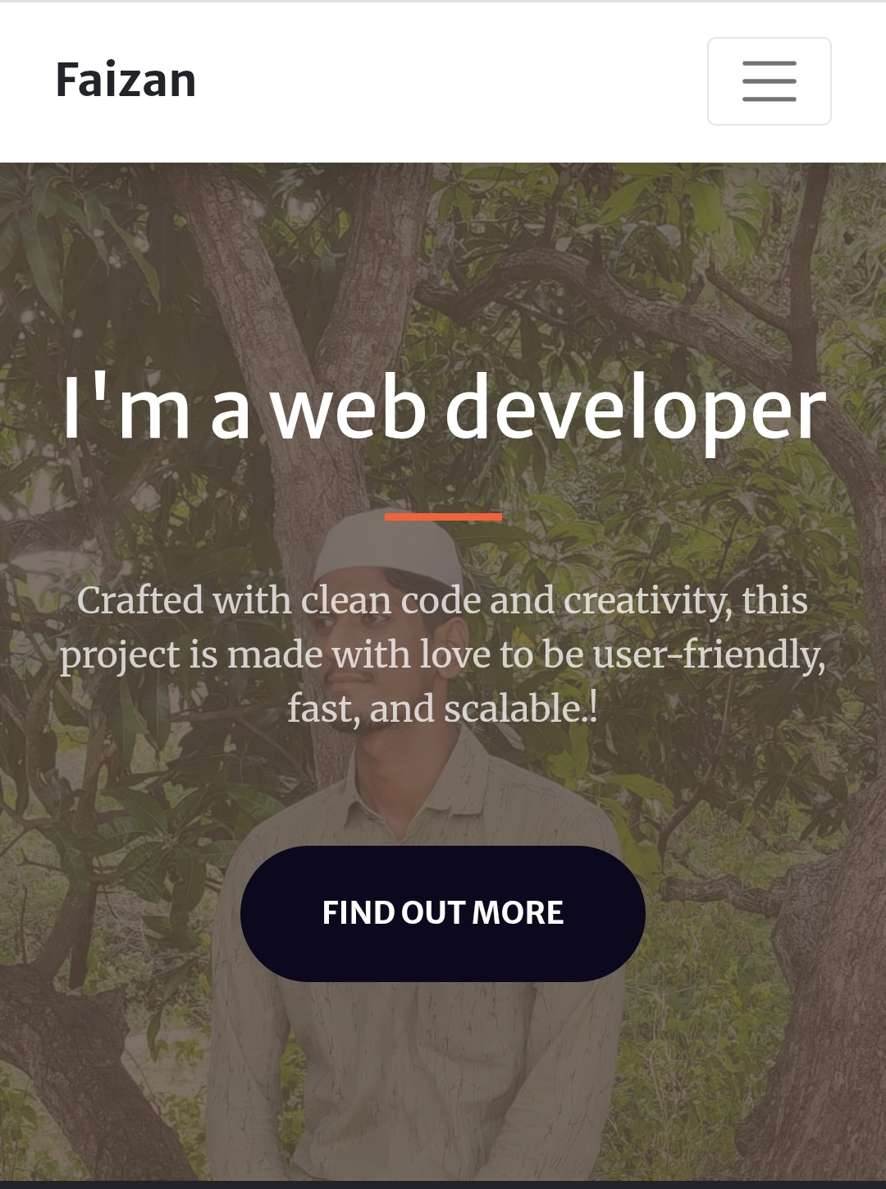
Results and screenshot
Crafted with clean code and creativity,this project is made with love to be user- friendly, fast, and scalable

Slide 9
Conclusion
“Through this portfolio, I have created a digital identity that not only reflects my skills and projects but also demonstrates my commitment to continuous learning and growth as a web developer.”

